Slide 1
PYTHON PROGRAMMING & DATA SCIENCE

Slide 2

Perceptron
Perceptron:
Perceptron is an artificial neural network unit that does calculations to understand the data better.
A group of artificial neurons interconnected with each other through synaptic connections is known as a neural network
An artificial neuron is a complex mathematical function, which takes input and weights separately, merge them together and pass it through the mathematical function to produce output.
By means of the synapse, a neuron can transmit signals or information to another neuron nearby. Process it and signal the next one. The process continues, until an output signal is produced.

Slide 3
Perceptron
Perceptron Learning Algorithm
In machine learning, the perceptron is an algorithm for supervised learning of binary classifiers.
A binary classifier is a function which can decide whether or not an input, represented by a vector of numbers, belongs to some specific class.
It is a type of linear classifier, i.e. a classification algorithm that makes its predictions based on a linear predictor function combining a set of weights with the feature vector.

Slide 4
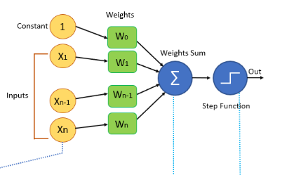
Perceptron
Perceptron Algorithm Block Diagram

Slide 5
Perceptron
Perceptron Algorithm Block Diagram
The terminology of the above diagram are:
Input:
All the features of the model we want to train the neural network will be passed as the input to it, Like the set of features [X1, X2, X3…..Xn]. Where n represents the total number of features and X represents the value of the feature.
Weights:
Initially, we have to pass some random values as values to the weights and these values get automatically updated after each training error that is the values are generated during the training of the model. In some cases, weights can also be called as weight coefficients.

Slide 6
Perceptron
Perceptron Algorithm Block Diagram
Weights Sum:
Each input value will be first multiplied with the weight assigned to it and the sum of all the multiplied values is known as a weighted sum.
Weights sum = ∑Wi * Xi (from i=1 to i=n) + (W0 * 1)

Slide 7
Perceptron
Step or Activation Function
Activation function applies step rule which converts the numerical value to 0 or 1 so that it will be easy for data set to classify.
Based on the type of value we need as output we can change the activation function.
Sigmoid function:
if we want values to be between 0 and 1 we can use a sigmoid function that has a smooth gradient as well.
2. Sign function:
if we want values to be +1 and -1 then we can use sign function.
3. hyperbolic tangent function:
The hyperbolic tangent function is a zero centered function making it easy for the multilayer neural networks.

Slide 8
Perceptron
Step or Activation Function
Relu function:
Relu function is highly computational but it cannot process input values that approach zero.
It is good for the values that are both greater than and less than a Zero.

Slide 9
Perceptron
Bias
It is a special type of classifier which is also known as synapse. Even it helps input vectors to get the correct answer
In the diagram, we have passed value one as input in the starting and W0 in the weights section .
W0 is an element that adjusts the boundary away from origin to move the activation function left, right, up or down.
since we want this to be independent of the input features, we add constant one in the statement so the features will not get affected by this and this value is known as Bias.

Slide 10
Perceptron
Types of Perceptron Algorithm:
Perceptron algorithms can be divided into two types . They are
single layer perceptrons and
multi-layer perceptron’s.
In single-layer perceptron’s neurons are organized in one layer.
In a multilayer perceptron’s a group of neurons will be organized in multiple layers.
Every single neuron present in the first layer will take the input signal and send a response to the neurons in the second layer and so on.

Slide 11
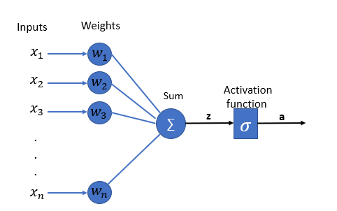
Perceptron
Types of Perceptron Algorithm:
Single Layer Perceptron

Slide 12
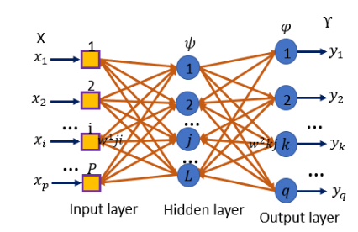
Perceptron
Types of Perceptron Algorithm:
Multi-Layer Perceptron

Slide 13
Perceptron
Perceptron Learning Steps
Features of the model we want to train should be passed as input to the perceptrons in the first layer.
These inputs will be multiplied by the weights or weight coefficients and the production values from all perceptrons will be added .
Adds the Bias value, to move the output function away from the origin.
This computed value will be fed to the activation function.
result value from the activation function is the output value.

